Slide 2
Sequential Circuits
Asynchronous
Synchronous
Combinational
Circuit
Inputs
Outputs
Memory Elements
Combinational
Circuit
Inputs
Outputs
Flip-flops
Clock

Slide 3
Latches
SR Latch
S R Q₀ | Q | Q’
0 0 0
0 | 1
Q = Q₀
0
0
0
1
Initial Value

Slide 4
Latches
SR Latch
S R Q₀ | Q | Q’
0 0 0 | 0 | 1
0 0 1
Q = Q₀
1 | 0
Q = Q₀
0
1
0
0

Slide 5
Latches
SR Latch
S R Q₀ | Q | Q’
0 0 0 | 0 | 1
0 0 1 | 1 | 0
0 1 0 | 0
Q = Q₀
1
 | 1
Q = 0
0
0
1

Slide 6
Latches
SR Latch
S R Q₀ | Q | Q’
0 0 0 | 0 | 1
0 0 1 | 1 | 0
0 1 0 | 0 | 1
0 1 1
Q = Q₀
1
Q = 0
1
0 | 1
Q = 0
0
0

Slide 7
Latches
SR Latch
S R Q₀ | Q | Q’
0 0 0 | 0 | 1
0 0 1 | 1 | 0
0 1 0 | 0 | 1
0 1 1 | 0 | 1
1 0 0
Q = Q₀
0
0
Q = 0
1 | 0
Q = 1
1
1

Slide 8
Latches
SR Latch
S R Q₀ | Q | Q’
0 0 0 | 0 | 1
0 0 1 | 1 | 0
0 1 0 | 0 | 1
0 1 1 | 0 | 1
1 0 0 | 1 | 0
1 0 1
Q = Q₀
0
1
Q = 0
Q = 1
1 | 0
Q = 1
1
0

Slide 9
Latches
SR Latch
S R Q₀ | Q | Q’
0 0 0 | 0 | 1
0 0 1 | 1 | 0
0 1 0 | 0 | 1
0 1 1 | 0 | 1
1 0 0 | 1 | 0
1 0 1 | 1 | 0
1 1 0
Q = Q₀
1
0
Q = 0
Q = 1
0 | 0
Q = Q’
1
1
0

Slide 10
Latches
SR Latch
S R Q₀ | Q | Q’
0 0 0 | 0 | 1
0 0 1 | 1 | 0
0 1 0 | 0 | 1
0 1 1 | 0 | 1
1 0 0 | 1 | 0
1 0 1 | 1 | 0
1 1 0 | 0 | 0
1 1 1
Q = Q₀
1
1
Q = 0
0
Q = 1
Q = Q’
0 | 0
Q = Q’
1
0

Slide 11
Latches
SR Latch
S R | Q
0 0 | Q₀
0 1 | 0
1 0 | 1
1 1 | Q=Q’=0
No change
Reset
Set
Invalid
S R | Q
0 0 | Q=Q’=1
0 1 | 1
1 0 | 0
1 1 | Q₀
Invalid
Set
Reset
No change

Slide 12
Latches
SR Latch
S R | Q
0 0 | Q₀
0 1 | 0
1 0 | 1
1 1 | Q=Q’=0
No change
Reset
Set
Invalid
S’ R’ | Q
0 0 | Q=Q’=1
0 1 | 1
1 0 | 0
1 1 | Q₀
Invalid
Set
Reset
No change

Slide 13
Controlled Latches
SR Latch with Control Input
C S R | Q
0 x x | Q₀
1 0 0 | Q₀
1 0 1 | 0
1 1 0 | 1
1 1 1 | Q=Q’
No change
No change
Reset
Set
Invalid

Slide 14
Controlled Latches
D Latch (D = Data)
Timing Diagram
C
D
Q
t
C D | Q
0 x | Q₀
1 0 | 0
1 1 | 1
Output may change
No change
Reset
Set

Slide 15
Controlled Latches
D Latch (D = Data)
Timing Diagram
C
D
Q
C D | Q
0 x | Q₀
1 0 | 0
1 1 | 1
Output may change
No change
Reset
Set

Slide 16
Flip-Flops
Controlled latches are level-triggered
Flip-Flops are edge-triggered
C
CLK
Positive Edge
CLK
Negative Edge

Slide 17
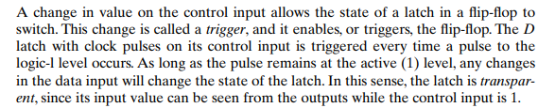
Issue with latch

Slide 18
Note that the problem with the latch is that it is transparent: As soon as an input changes, shortly thereafter the corresponding output changes to match it. This transparency is what allows a change on a latch output to produce additional changes at other latch outputs while the clock pulse is at logic 1. The key to the proper operation of flip-flops is to prevent them from being transparent. In a flipflop, before an output can change, the path from its inputs to its outputs is broken. So, a flip-flop cannot “see” the change of its output or of the outputs of other, similar flip-flops at its input during the same clock pulse. Thus, the new state of a flip-flop depends only on the immediately preceding state, and the flip-flops do not go through multiple changes of state. There are two ways that latches are combined to form a flip-flop. One way is to combine two latches such that (1) the inputs presented to the flip-flop when a clock pulse is present control its state and (2) the state of the flip-flop changes only when a clock pulse is not present. Such a circuit is called a master–slave flipflop. Another way is to produce a flip-flop that triggers only during a signal transition from 0 to 1 (or from 1 to 0) on the clock and that is disabled at all other times, including for the duration of the clock pulse. Such a circuit is said to be an edge-triggered flip-flop.

Slide 19
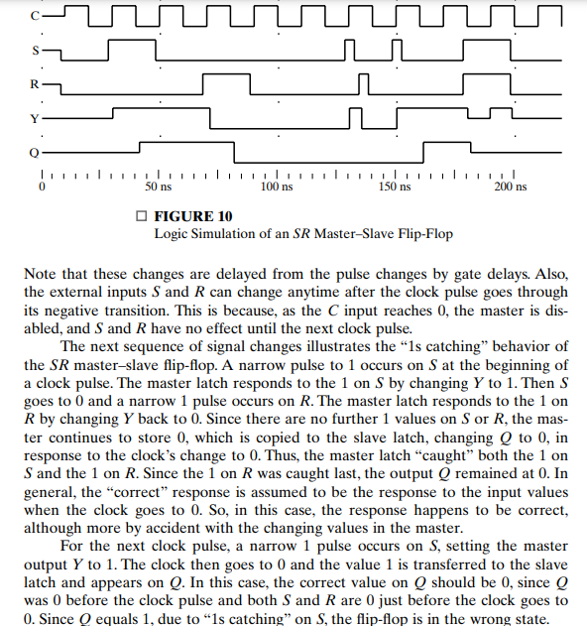
1s catching problem

Slide 20
Flip-Flops
Master-Slave D Flip-Flop
D Latch
(Master)
D Latch
(Slave)
D
D
C
Q
D
C
Q
Q
Master
Slave
CLK
CLK
D
Looks like it is negative edge-triggered
Q_{Master}
Q_{Slave}

Slide 21
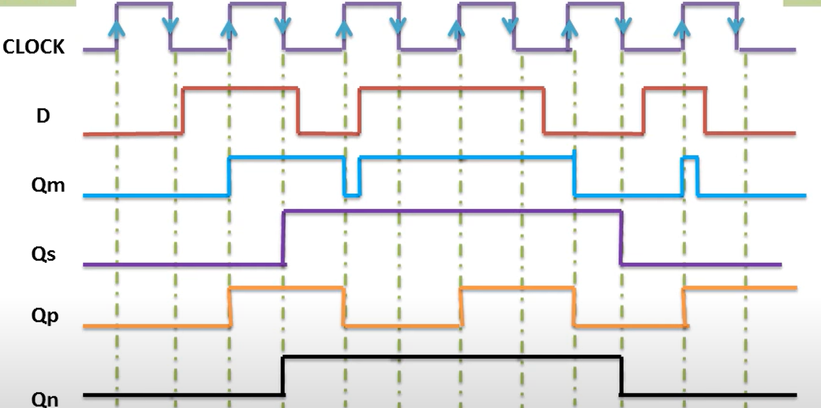
EDGE TRIGGERING OF D FLIP FLOP

Slide 22
Flip-Flops
Edge-Triggered D Flip-Flop
D
Q
Q
Positive Edge
D
Q
Q
Negative Edge
Notes:
CP
D
R
S
Q(t+1)
0
0
1
1
PS
0
1
1
1
PS
1
0
1
0
0 reset
1
1
1
0
0
0
X
1
1
PS
1
1
0
1
1set

Slide 23
Edge-Triggered D Flip-Flop
CP | D | S | R | Q(t+1)
0 | 0 | 1 | 1 | PS
0 | 1 | 1 | 1 | PS
1 | 0 | 1 | 0 | 0Reset
1 | 1 | 1 | 0 | 0
0 | X | 1 | 1 | PS
1 | 1 | 0 | 1 | 1set
1 | 0 | 0 | 1 | 1set

Slide 24
Flip-Flops
JK Flip-Flop
J
Q
D = JQ’ + K’Q
K
Q

Slide 25
Flip-Flops
T Flip-Flop
T
J
Q
T
D
Q
Q
K
Q
T
Q
D = JQ’ + K’Q
D = TQ’ + T’Q = T ⊕ Q
Q

Slide 26
Flip-Flop Characteristic Tables
D | Q(t+1)
0 | 0
1 | 1
D
Q
Reset
Set
Q
J | K | Q(t+1)
0 | 0 | Q(t)
0 | 1 | 0
1 | 0 | 1
1 | 1 | Q’(t)
J
Q
No change
Reset
Set
Toggle
K
Q
T
Q
T | Q(t+1)
0 | Q(t)
1 | Q’(t)
No change
Toggle
Q

Slide 27
Flip-Flop Characteristic Equations
D | Q(t+1)
0 | 0
1 | 1
D
Q
Q(t+1) = D
Q
J | K | Q(t+1)
0 | 0 | Q(t)
0 | 1 | 0
1 | 0 | 1
1 | 1 | Q’(t)
J
Q
Q(t+1) = JQ’ + K’Q
K
Q
T
Q
T | Q(t+1)
0 | Q(t)
1 | Q’(t)
Q(t+1) = T ⊕ Q
Q

Slide 28
Flip-Flop Characteristic Equations
Analysis / Derivation
J | K | Q(t) | Q(t+1)
0 | 0 | 0 | 0
0 | 0 | 1 | 1
0 | 1 | 0
0 | 1 | 1
1 | 0 | 0
1 | 0 | 1
1 | 1 | 0
1 | 1 | 1
No change
Reset
Set
Toggle
J
Q
K
Q

Slide 29
Flip-Flop Characteristic Equations
Analysis / Derivation
J | K | Q(t) | Q(t+1)
0 | 0 | 0 | 0
0 | 0 | 1 | 1
0 | 1 | 0 | 0
0 | 1 | 1 | 0
1 | 0 | 0
1 | 0 | 1
1 | 1 | 0
1 | 1 | 1
No change
Reset
Set
Toggle
J
Q
K
Q

Slide 30
Flip-Flop Characteristic Equations
Analysis / Derivation
J | K | Q(t) | Q(t+1)
0 | 0 | 0 | 0
0 | 0 | 1 | 1
0 | 1 | 0 | 0
0 | 1 | 1 | 0
1 | 0 | 0 | 1
1 | 0 | 1 | 1
1 | 1 | 0
1 | 1 | 1
No change
Reset
Set
Toggle
J
Q
K
Q

Slide 31
Flip-Flop Characteristic Equations
Analysis / Derivation
J | K | Q(t) | Q(t+1)
0 | 0 | 0 | 0
0 | 0 | 1 | 1
0 | 1 | 0 | 0
0 | 1 | 1 | 0
1 | 0 | 0 | 1
1 | 0 | 1 | 1
1 | 1 | 0 | 1
1 | 1 | 1 | 0
No change
Reset
Set
Toggle
J
Q
K
Q

Slide 32
Flip-Flop Characteristic Equations
Analysis / Derivation
J | K | Q(t) | Q(t+1)
0 | 0 | 0 | 0
0 | 0 | 1 | 1
0 | 1 | 0 | 0
0 | 1 | 1 | 0
1 | 0 | 0 | 1
1 | 0 | 1 | 1
1 | 1 | 0 | 1
1 | 1 | 1 | 0
J
Q
 |  |  |  | K
 |  | 0 | 1 | 0 | 0
J |  | 1 | 1 | 0 | 1
 |  |  | Q
K
Q
Q(t+1) = JQ’ + K’Q

Slide 33
Flip-Flops with Direct Inputs
Asynchronous Reset
R’ | D | CLK | Q(t+1)
0 | x | x | 0
D
Q
Q
R
Reset

Slide 34
Flip-Flops with Direct Inputs
Asynchronous Reset
R’ | D | CLK | Q(t+1)
0 | x | x | 0
1 | 0 | ↑ | 0
1 | 1 | ↑ | 1
D
Q
Q
R
Reset

Slide 35
Flip-Flops with Direct Inputs
Asynchronous Preset and Clear
Preset
PR’ | CLR’ | D | CLK | Q(t+1)
1 | 0 | x | x | 0
PR
D
Q
Q
CLR
Reset

Slide 36
Flip-Flops with Direct Inputs
Asynchronous Preset and Clear
Preset
PR’ | CLR’ | D | CLK | Q(t+1)
1 | 0 | x | x | 0
0 | 1 | x | x | 1
PR
D
Q
Q
CLR
Reset

Slide 37
Flip-Flops with Direct Inputs
Asynchronous Preset and Clear
Preset
PR’ | CLR’ | D | CLK | Q(t+1)
1 | 0 | x | x | 0
0 | 1 | x | x | 1
1 | 1 | 0 | ↑ | 0
1 | 1 | 1 | ↑ | 1
PR
D
Q
Q
CLR
Reset

Slide 38
Analysis of Clocked Sequential Circuits
The State
State = Values of all Flip-Flops
Example
A B = 0 0

Slide 39
Analysis of Clocked Sequential Circuits
State Equations
A(t+1) = D_{A}
= A(t) x(t)+B(t) x(t)
= A x + B x
B(t+1) = D_{B}
= A’(t) x(t)
= A’ x
y(t) = [A(t)+ B(t)] x’(t)
= (A + B) x’

Slide 40
Analysis of Clocked Sequential Circuits
State Table (Transition Table)
Present State |  | Input | Next State |  | Output
A | B | x | A | B | y
0 | 0 | 0
0 | 0 | 1
0 | 1 | 0
0 | 1 | 1
1 | 0 | 0
1 | 0 | 1
1 | 1 | 0
1 | 1 | 1
0 0 0
0 1 0
0 0 1
1 1 0
0 0 1
1 0 0
0 0 1
1 0 0
A(t+1) = A x + B x
B(t+1) = A’ x
y(t) = (A + B) x’
t
t+1
t

Slide 41
Analysis of Clocked Sequential Circuits
State Table (Transition Table)
Present State |  |  | Next State |  |  |  | Output
 |  |  | x = 0 |  | x = 1 |  | x = 0 | x = 1
A |  | B | A | B | A | B | y | y
0 |  | 0 | 0 | 0 | 0 | 1 | 0 | 0
0 |  | 1 | 0 | 0 | 1 | 1 | 1 | 0
1 |  | 0 | 0 | 0 | 1 | 0 | 1 | 0
1 |  | 1 | 0 | 0 | 1 | 0 | 1 | 0
t
t+1
t
A(t+1) = A x + B x
B(t+1) = A’ x
y(t) = (A + B) x’

Slide 42
Analysis of Clocked Sequential Circuits
State Diagram
Present State |  |  | Next State |  |  |  | Output
 |  |  | x = 0 |  | x = 1 |  | x = 0 | x = 1
A |  | B | A | B | A | B | y | y
0 |  | 0 | 0 | 0 | 0 | 1 | 0 | 0
0 |  | 1 | 0 | 0 | 1 | 1 | 1 | 0
1 |  | 0 | 0 | 0 | 1 | 0 | 1 | 0
1 |  | 1 | 0 | 0 | 1 | 0 | 1 | 0
AB
input/output
0/0
1/0
0/1
0 0
1 0
0/1
1/0
0/1
1/0
0 1
1 1
1/0

Slide 43
Analysis of Clocked Sequential Circuits
D Flip-Flops
Example:
x
D
Q
A
y
Present State | Input |  | Next State
A | x | y | A
0 | 0 | 0
0 | 0 | 1
0 | 1 | 0
0 | 1 | 1
1 | 0 | 0
1 | 0 | 1
1 | 1 | 0
1 | 1 | 1
CLK
Q
0
1
1
0
1
0
0
1
A(t+1) = D_{A} = A ⊕ x ⊕ y
01,10
0
1
00,11
00,11
01,10

Slide 44
Analysis of Clocked Sequential Circuits
JK Flip-Flops
Example:
Present State |  | I/P | Next State |  | Flip-Flop Inputs
A | B | x | A | B | J_{A} | K_{A} | J_{B} | K_{B}
0 | 0 | 0
0 | 0 | 1
0 | 1 | 0
0 | 1 | 1
1 | 0 | 0
1 | 0 | 1
1 | 1 | 0
1 | 1 | 1
0 1
0 0
1 1
1 0
1 1
1 0
0 0
1 1
0 0 1 0
0 0 0 1
1 1 1 0
1 0 0 1
0 0 1 1
0 0 0 0
1 1 1 1
1 0 0 0
J_{A} = B K_{A} = B x’
J_{B} = x’ K_{B} = A ⊕ x
A(t+1) = J_{A} Q’_{A} + K’_{A} Q_{A}
= A’B + AB’ + Ax
B(t+1) = J_{B} Q’_{B} + K’_{B} Q_{B}
= B’x’ + ABx + A’Bx’

Slide 45
Analysis of Clocked Sequential Circuits
JK Flip-Flops
Example:
Present State |  | I/P | Next State |  | Flip-Flop Inputs
A | B | x | A | B | J_{A} | K_{A} | J_{B} | K_{B}
0 | 0 | 0
0 | 0 | 1
0 | 1 | 0
0 | 1 | 1
1 | 0 | 0
1 | 0 | 1
1 | 1 | 0
1 | 1 | 1
0 1
0 0
1 1
1 0
1 1
1 0
0 0
1 1
0 0 1 0
0 0 0 1
1 1 1 0
1 0 0 1
0 0 1 1
0 0 0 0
1 1 1 1
1 0 0 0
1
0
1
0 0
1 1
0
0
0
0 1
1 0
1
1

Slide 46
Analysis of Clocked Sequential Circuits
T Flip-Flops
Example:
Present State |  | I/P | Next State |  | F.F Inputs |  | O/P
A | B | x | A | B | T_{A} | T_{B} | y
0 | 0 | 0
0 | 0 | 1
0 | 1 | 0
0 | 1 | 1
1 | 0 | 0
1 | 0 | 1
1 | 1 | 0
1 | 1 | 1
0 0
0 1
0 1
1 0
1 0
1 1
1 1
0 0
0 0
0 1
0 0
1 1
0 0
0 1
0 0
1 1
0
0
0
0
0
0
1
1
T_{A} = B x T_{B} = x
y = A B
A(t+1) = T_{A} Q’_{A} + T’_{A} Q_{A}
= AB’ + Ax’ + A’Bx
B(t+1) = T_{B} Q’_{B} + T’_{B} Q_{B}
= x ⊕ B

Slide 47
Analysis of Clocked Sequential Circuits
T Flip-Flops
Example:
Present State |  | I/P | Next State |  | F.F Inputs |  | O/P
A | B | x | A | B | T_{A} | T_{B} | y
0 | 0 | 0
0 | 0 | 1
0 | 1 | 0
0 | 1 | 1
1 | 0 | 0
1 | 0 | 1
1 | 1 | 0
1 | 1 | 1
0 0
0 1
0 1
1 0
1 0
1 1
1 1
0 0
0 0
0 1
0 0
1 1
0 0
0 1
0 0
1 1
0
0
0
0
0
0
1
1
0/0
0/0
0 0
1/0
0 1
1/1
1/0
1 1
1 0
0/1
0/0
1/0

Slide 48
Mealy and Moore Models
The Mealy model: the outputs are functions of both the present state and inputs (Fig. 5-15).
The outputs may change if the inputs change during the clock pulse period.
The outputs may have momentary false values unless the inputs are synchronized with the clocks.
The Moore model: the outputs are functions of the present state only (Fig. 5-20).
The outputs are synchronous with the clocks.

Slide 49
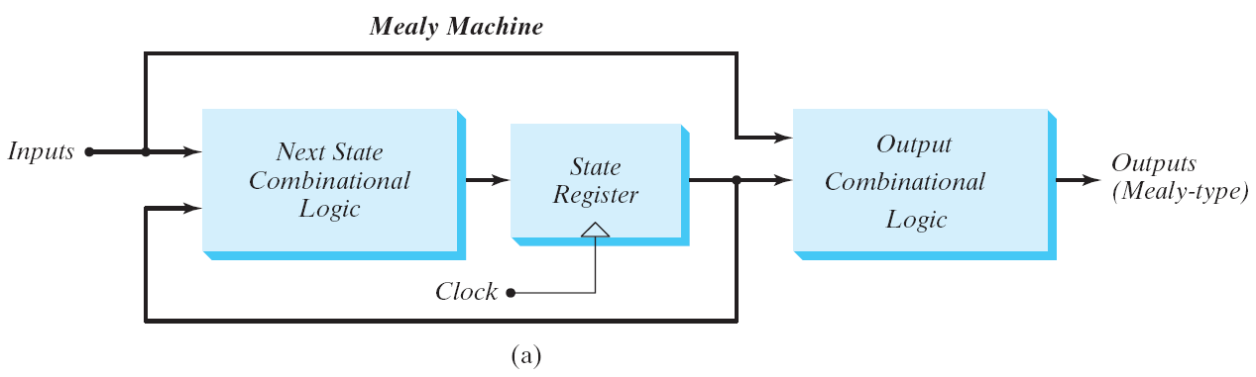
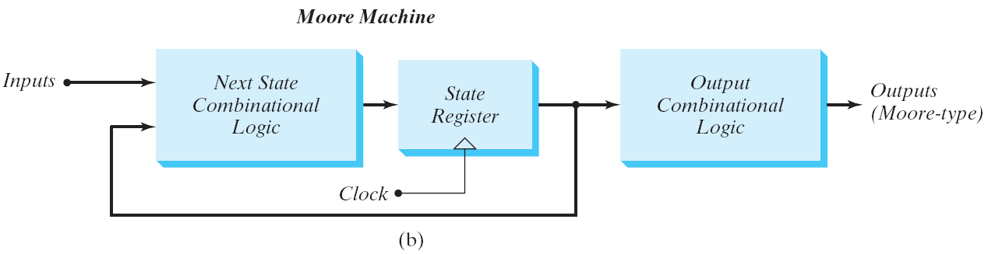
Mealy and Moore Models
Fig. 5.21 Block diagram of Mealy and Moore state machine

Slide 50
Mealy and Moore Models
Mealy
Moore
Present State |  | I/P | Next State |  | O/P
A | B | x | A | B | y
0 | 0 | 0 | 0 | 0 | 0
0 | 0 | 1 | 0 | 1 | 0
0 | 1 | 0 | 0 | 0 | 1
0 | 1 | 1 | 1 | 1 | 0
1 | 0 | 0 | 0 | 0 | 1
1 | 0 | 1 | 1 | 0 | 0
1 | 1 | 0 | 0 | 0 | 1
1 | 1 | 1 | 1 | 0 | 0
Present State |  | I/P | Next State |  | O/P
A | B | x | A | B | y
0 | 0 | 0 | 0 | 0 | 0
0 | 0 | 1 | 0 | 1 | 0
0 | 1 | 0 | 0 | 1 | 0
0 | 1 | 1 | 1 | 0 | 0
1 | 0 | 0 | 1 | 0 | 0
1 | 0 | 1 | 1 | 1 | 0
1 | 1 | 0 | 1 | 1 | 1
1 | 1 | 1 | 0 | 0 | 1
For the same state, the output changes with the input
For the same state, the output does not change with the input

Slide 51
Moore State Diagram
State / Output
0
0
1
0 0 / 0
0 1 / 0
1
1
1 1 / 1
1 0 / 0
1
0
0

Slide 52
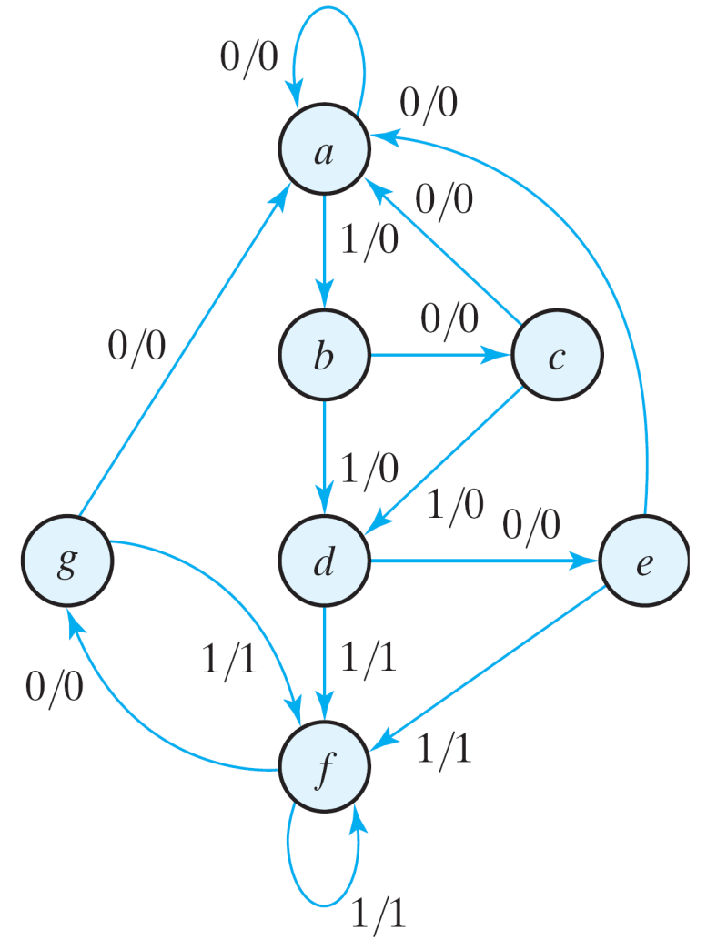
State Reduction and Assignment
State Reduction Reductions on the number of flip-flops and the number of gates.
A reduction in the number of states may result in a reduction in the number of flip-flops.
An example state diagram showing in Fig. 5.25.
Fig. 5.25 State diagram

Slide 53
State Reduction
Only the input-output sequences are important.
Two circuits are equivalent
Have identical outputs for all input sequences;
The number of states is not important.
State: | a | a | b | c | d | e | f | f | g | f | g | a
Input: | 0 | 1 | 0 | 1 | 0 | 1 | 1 | 0 | 1 | 0 | 0
Output: | 0 | 0 | 0 | 0 | 0 | 1 | 1 | 0 | 1 | 0 | 0
Fig. 5.25 State diagram

Slide 54
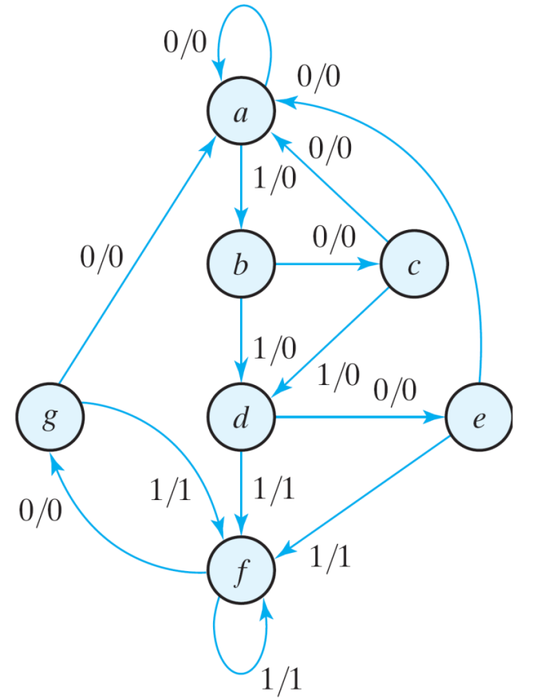
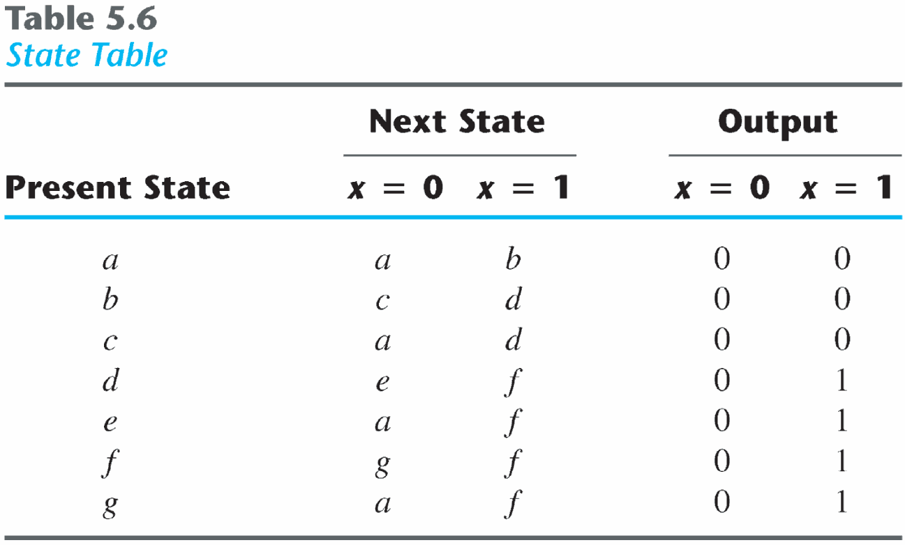
Equivalent states
Two states are said to be equivalent
For each member of the set of inputs, they give exactly the same output and send the circuit to the same state or to an equivalent state.
One of them can be removed.

Slide 55
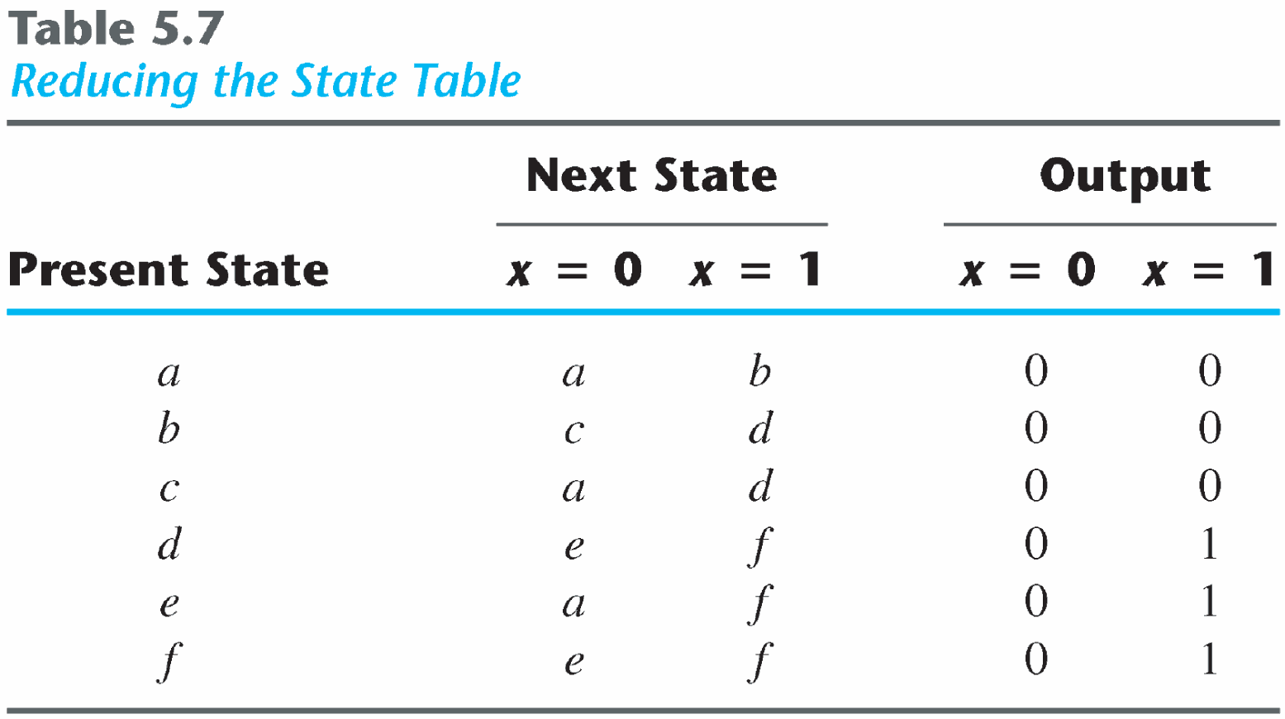
Reducing the state table
e = g (remove g);
d = f (remove f);

Slide 56
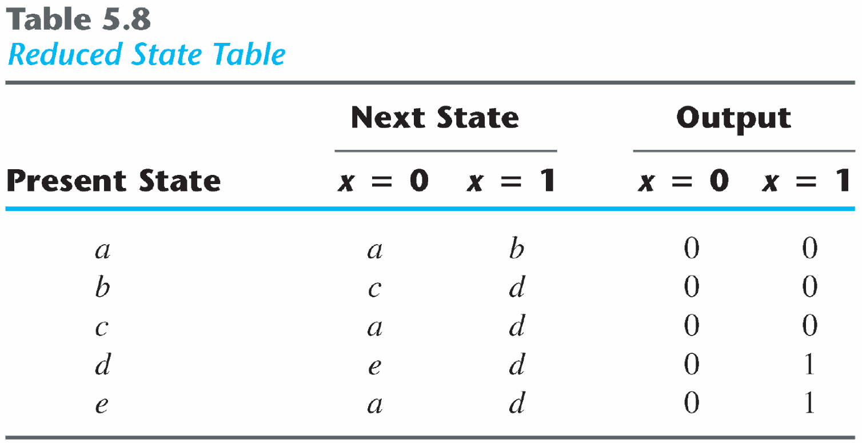
State: | a | a | b | c | d | e | d | d | e | d | e | a
Input: | 0 | 1 | 0 | 1 | 0 | 1 | 1 | 0 | 1 | 0 | 0
Output: | 0 | 0 | 0 | 0 | 0 | 1 | 1 | 0 | 1 | 0 | 0
The reduced finite state machine

Slide 57
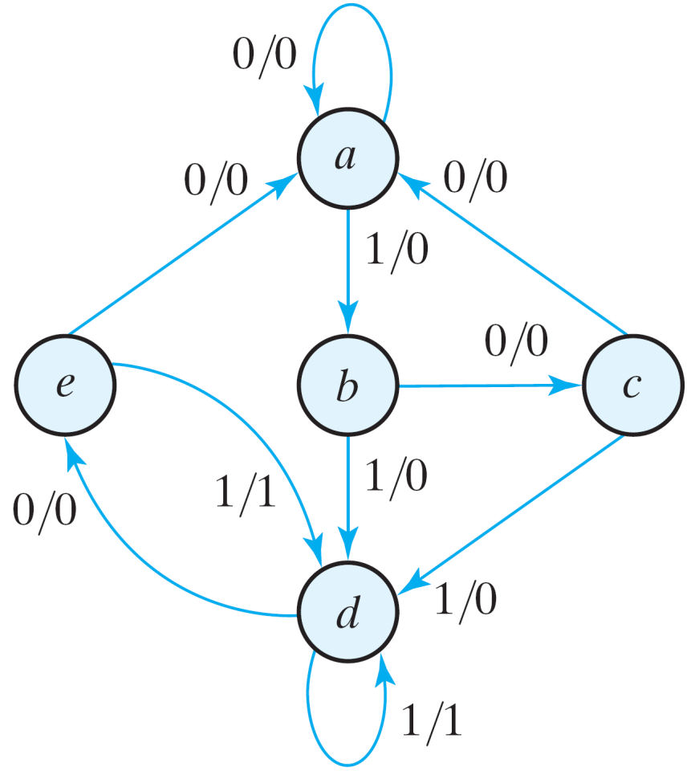
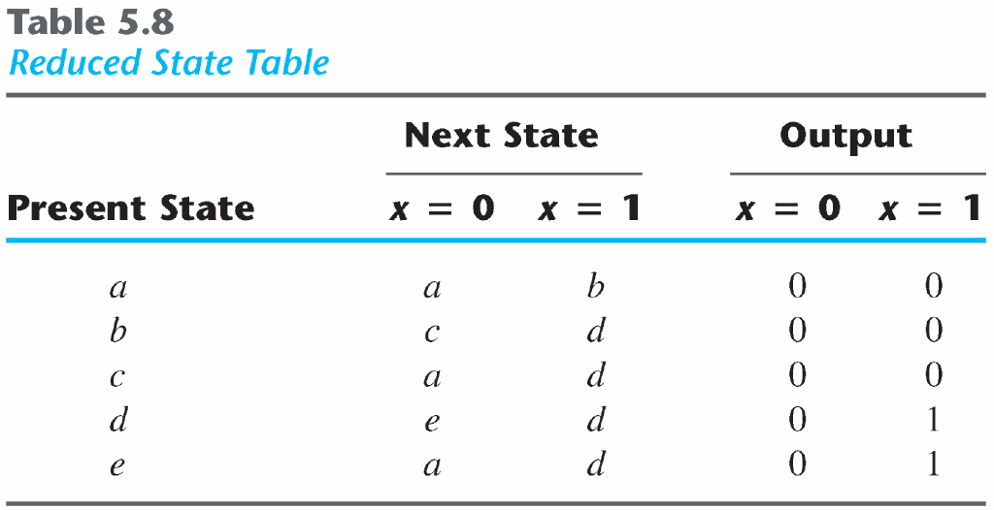
The checking of each pair of states for possible equivalence can be done systematically using Implication Table.
The unused states are treated as don't-care condition ⇒ fewer combinational gates.
Fig. 5.26 Reduced State diagram

Slide 58
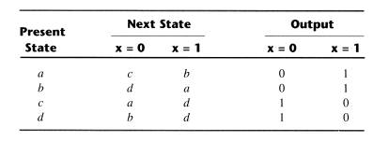
Implication Table
The state-reduction procedure for completely specified state tables is based on the algorithm that two states in a state table can be combined into one if they can be shown to be equivalent. There are occasions when a pair of states do not have the same next states, but, nonetheless, go to equivalent next states. Consider the following state table:
(a, b) imply (c, d) and (c, d) imply (a, b). Both pairs of states are equivalent; i.e., a and b are equivalent as well as c and d.

Slide 59
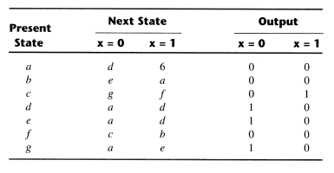
Implication Table
The checking of each pair of states for possible equivalence in a table with a large number of states can be done systematically by means of an implication table. This a chart that consists of squares, one for every possible pair of states, that provide spaces for listing any possible implied states. Consider the following state table:

Slide 60
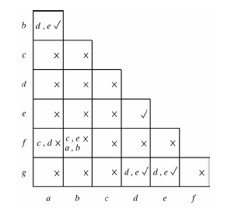
Implication Table
The implication table is:

Slide 61
Implication Table
On the left side along the vertical are listed all the states defined in the state table except the last, and across the bottom horizontally are listed all the states except the last.
The states that are not equivalent are marked with a ‘x’ in the corresponding square, whereas their equivalence is recorded with a ‘√’.
Some of the squares have entries of implied states that must be further investigated to determine whether they are equivalent or not.
The step-by-step procedure of filling in the squares is as follows:
Place a cross in any square corresponding to a pair of states whose outputs are not equal for every input.
Enter in the remaining squares the pairs of states that are implied by the pair of states representing the squares. We do that by starting from the top square in the left column and going down and then proceeding with the next column to the right.

Slide 62
Implication Table
3. Make successive passes through the table to determine whether any additional squares should be marked with a ‘x’. A square in the table is crossed out if it contains at least one implied pair that is not equivalent.
4. Finally, all the squares that have no crosses are recorded with check marks. The equivalent states are: (a, b), (d, e), (d, g), (e, g).
We now combine pairs of states into larger groups of equivalent states. The last three pairs can be combined into a set of three equivalent states (d, e,g) because each one of the states in the group is equivalent to the other two. The final partition of these states consists of the equivalent states found from the implication table, together with all the remaining states in the state table that are not equivalent to any other state:
(a, b) (c) (d, e, g) (f)
The reduced state table is:

Slide 63
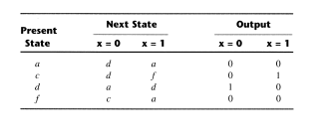
Implication Table

Slide 64
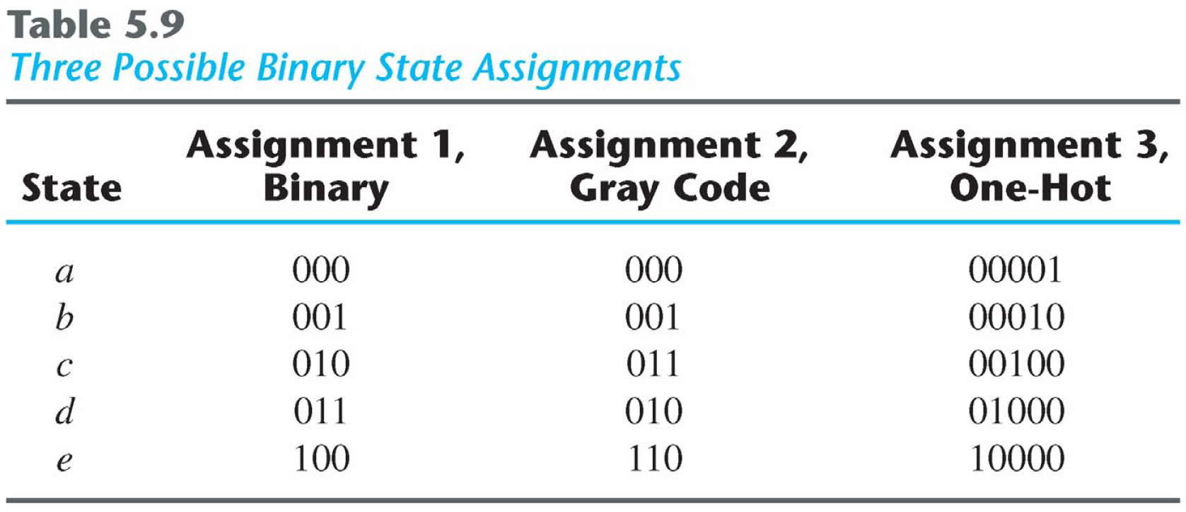
State Assignment
State Assignment
To minimize the cost of the combinational circuits.
Three possible binary state assignments. (m states need n-bits, where 2^{n} > m)

Slide 65
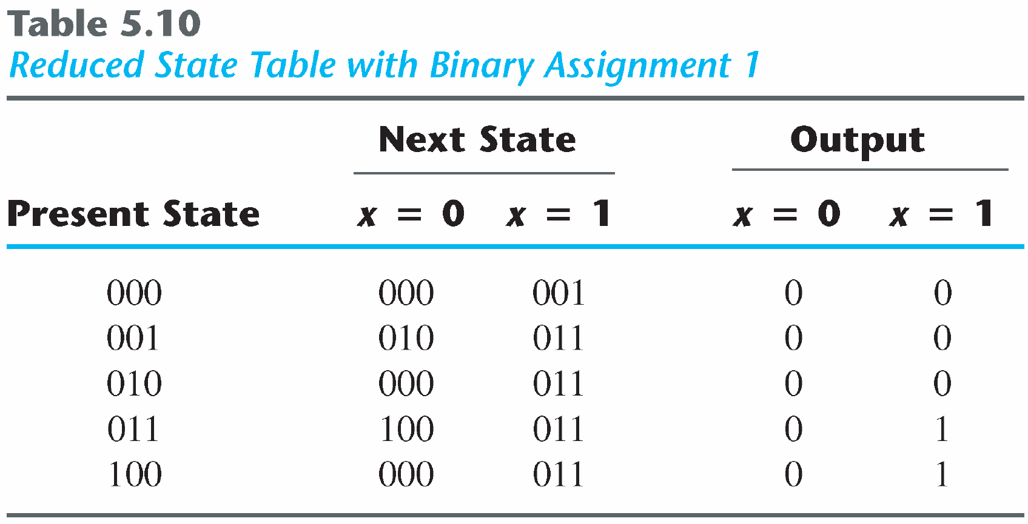
Any binary number assignment is satisfactory as long as each state is assigned a unique number.
Use binary assignment 1.

Slide 66
Design Procedure
Design Procedure for sequential circuit
The word description of the circuit behavior to get a state diagram;
State reduction if necessary;
Assign binary values to the states;
Obtain the binary-coded state table;
Choose the type of flip-flops;
Derive the simplified flip-flop input equations and output equations;
Draw the logic diagram;

Slide 67
Design of Clocked Sequential Circuits
Example:
Detect 3 or more consecutive 1’s
0
1
S₀ / 0
S₁ / 0
0
State | A B
S₀ | 0 0
S₁ | 0 1
S₂ | 1 0
S₃ | 1 1
0
1
0
S₃ / 1
S₂ / 0
1
1

Slide 68
Design of Clocked Sequential Circuits
Example:
Detect 3 or more consecutive 1’s
Present State |  | Input | Next State |  | Output
A | B | x | A | B | y
0 | 0 | 0
0 | 0 | 1
0 | 1 | 0
0 | 1 | 1
1 | 0 | 0
1 | 0 | 1
1 | 1 | 0
1 | 1 | 1
0
1
0 0 0
0 1 0
0 0 0
1 0 0
0 0 0
1 1 0
0 0 1
1 1 1
S₀ / 0
S₁ / 0
0
0
1
0
S₃ / 1
S₂ / 0
1
1

Slide 69
Design of Clocked Sequential Circuits
Example:
Detect 3 or more consecutive 1’s
Present State |  | Input | Next State |  | Output
A | B | x | A | B | y
0 | 0 | 0
0 | 0 | 1
0 | 1 | 0
0 | 1 | 1
1 | 0 | 0
1 | 0 | 1
1 | 1 | 0
1 | 1 | 1
Synthesis using D Flip-Flops
0 0 0
0 1 0
0 0 0
1 0 0
0 0 0
1 1 0
0 0 1
1 1 1
A(t+1) = D_{A} (A, B, x)
= ∑ (3, 5, 7)
B(t+1) = D_{B} (A, B, x)
= ∑ (1, 5, 7)
y (A, B, x) = ∑ (6, 7)

Slide 70
Design of Clocked Sequential Circuits with D F.F.
Example:
Detect 3 or more consecutive 1’s
Synthesis using D Flip-Flops
 |  |  |  | B
 |  | 0 | 0 | 1 | 0
A |  | 0 | 1 | 1 | 0
 |  |  | x
D_{A} (A, B, x) = ∑ (3, 5, 7)
= A x + B x
D_{B} (A, B, x) = ∑ (1, 5, 7)
= A x + B’ x
y (A, B, x) = ∑ (6, 7)
= A B
 |  |  |  | B
 |  | 0 | 1 | 0 | 0
A |  | 0 | 1 | 1 | 0
 |  |  | x
 |  |  |  | B
 |  | 0 | 0 | 0 | 0
A |  | 0 | 0 | 1 | 1
 |  |  | x

Slide 71
Design of Clocked Sequential Circuits with D F.F.
Example:
Detect 3 or more consecutive 1’s
Synthesis using D Flip-Flops
D_{A} = A x + B x
D_{B} = A x + B’ x
y = A B

Slide 72
Flip-Flop Excitation Tables
Present State | Next State | F.F. Input
Q(t) | Q(t+1) | D
0 | 0
0 | 1
1 | 0
1 | 1
Present State | Next State | F.F. Input
Q(t) | Q(t+1) | J | K
0 | 0
0 | 1
1 | 0
1 | 1
0 0 (No change)
0 1 (Reset)
0
1
0
1
0 x
1 x
x 1
x 0
1 0 (Set)
1 1 (Toggle)
0 1 (Reset)
1 1 (Toggle)
0 0 (No change)
1 0 (Set)
Q(t) | Q(t+1) | T
0 | 0
0 | 1
1 | 0
1 | 1
0
1
1
0

Slide 73
Design of Clocked Sequential Circuits with JK F.F.
Example:
Detect 3 or more consecutive 1’s
Present State |  | Input | Next State |  | Flip-Flop Inputs
A | B | x | A | B | J_{A} | K_{A} | J_{B} | K_{B}
0 | 0 | 0 | 0 | 0
0 | 0 | 1 | 0 | 1
0 | 1 | 0 | 0 | 0
0 | 1 | 1 | 1 | 0
1 | 0 | 0 | 0 | 0
1 | 0 | 1 | 1 | 1
1 | 1 | 0 | 0 | 0
1 | 1 | 1 | 1 | 1
Synthesis using JK F.F.
0 x
0 x
0 x
1 x
x 1
x 0
x 1
x 0
0 x
1 x
x 1
x 1
0 x
1 x
x 1
x 0
J_{A} (A, B, x) = ∑ (3)
d_{JA} (A, B, x) = ∑ (4,5,6,7)
K_{A} (A, B, x) = ∑ (4, 6)
d_{KA} (A, B, x) = ∑ (0,1,2,3)
J_{B} (A, B, x) = ∑ (1, 5)
d_{JB} (A, B, x) = ∑ (2,3,6,7)
K_{B} (A, B, x) = ∑ (2, 3, 6)
d_{KB} (A, B, x) = ∑ (0,1,4,5)

Slide 74
Design of Clocked Sequential Circuits with JK F.F.
Example:
Detect 3 or more consecutive 1’s
Synthesis using JK Flip-Flops
J_{A} = B x K_{A} = x’
J_{B} = x K_{B} = A’ + x’
 |  |  |  | B
 |  | 0 | 0 | 1 | 0
A |  | x | x | x | x
 |  |  | x
 |  |  |  | B
 |  | x | x | x | x
A |  | 1 | 0 | 0 | 1
 |  |  | x
 |  |  |  | B
 |  | 0 | 1 | x | x
A |  | 0 | 1 | x | x
 |  |  | x
 |  |  |  | B
 |  | x | x | 1 | 1
A |  | x | x | 0 | 1
 |  |  | x

Slide 75
Design of Clocked Sequential Circuits with T F.F.
Example:
Detect 3 or more consecutive 1’s
Present State |  | Input | Next State |  | F.F. Input
A | B | x | A | B | T_{A} T_{B}
0 | 0 | 0 | 0 | 0
0 | 0 | 1 | 0 | 1
0 | 1 | 0 | 0 | 0
0 | 1 | 1 | 1 | 0
1 | 0 | 0 | 0 | 0
1 | 0 | 1 | 1 | 1
1 | 1 | 0 | 0 | 0
1 | 1 | 1 | 1 | 1
Synthesis using T Flip-Flops
0
0
0
1
1
0
1
0
0
1
1
1
0
1
1
0
T_{A} (A, B, x) = ∑ (3, 4, 6)
T_{B} (A, B, x) = ∑ (1, 2, 3, 5, 6)

Slide 76
Design of Clocked Sequential Circuits with T F.F.
Example:
Detect 3 or more consecutive 1’s
Synthesis using T Flip-Flops
T_{A} = A x’ + A’ B x
T_{B} = A’ B + B ⊕ x
 |  |  |  | B
 |  | 0 | 0 | 1 | 0
A |  | 1 | 0 | 0 | 1
 |  |  | x
 |  |  |  | B
 |  | 0 | 1 | 1 | 1
A |  | 0 | 1 | 0 | 1
 |  |  | x

